Slide 1
COMMUNICATION: BASIC PRINCIPLES
Nicoletta Di Blas - Introduction

Slide 2
What is a sign?
Definitions by Thomas Aquinas
Communiter possumus signum dicere quodcumque notum in quo aliquid cognoscatur (Quaestiones disputatae de Veritate, q.9, a.4, ad 4)
Signum, quantum est in se, importat aliquid manifestum quo ad nos, quo manuducimur in cognitionem alicuius occulti (Scriptum super quatuor libris Sententiarum Magistri Petri Lombardi, IV, d. 1, q. 1, a. 1, ad 5)
Notes:
TRANSLATIONS:
«Generally speaking, we can say that a sign is anything that we can perceive through which we get to know something else»
«The sign in itself is something that we can perceive through which we are ‘led by the hand’ to know something that is ‘hidden’ [i.e. non necessarily present in the context]»

Slide 3
Linguistic signs “stand for”…
Four disrupting consequences:
Knowledge (passing on – knowing things we do not experience)
Philosophical thinking (e.g. the concept of “in-finite”)
Creativity
Lies (please don’t!)
Notes:
Linguistic signs: they «stand for» something else.
Consequences:
Knowledge: we can know something not through direct acquaintance but through someone else’s experience (told in words). E.g. the North Pole: we can know «about» the North Pole a lot of things even without having actually been there.
Philosophy: we can think about concepts even without being sure that they exist in reality (is the universe infinite or finite? – we do not know, but we can conceive the concept of ‘infiniteness’)
Creativity: we can think of new things; this is often the first step towards innovation (will «teletransportation» ever exist? We do not know, but we can think about it). We can create literary works works of art, stories…
Lies: we can put together things that are not together, we can lie.

Slide 4
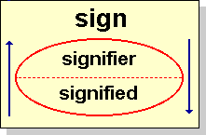
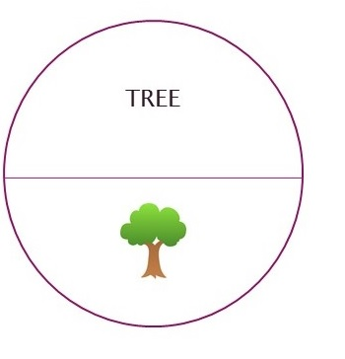
What is a sign (F. De Saussure)
Notes:
In Saussure’s theory, the sign relation is dyadic: a signifier stands for a signified.
Both live in the «heads» of the speakers and are « mental models»: trees are infinite – still when we see a specific tree we recognize it; the ways of pronouncing the word «tree» are infinite, still when we hear that word we recognize it.
This is the difference between what may be called «TYPES» (mental models) and «TOKENS» (concrete instances).

Slide 5
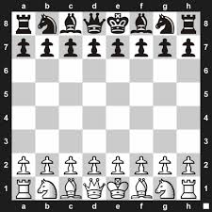
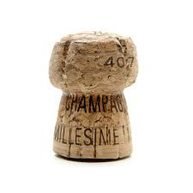

Arbitrariness of signs: the signifier
Pieces over a chessboard: what matters is that they are different from one another
=
Notes:
Signs are arbitrary: there is no specific reason why a house should be called «house» (actually in Italian we have the word «casa»).
What matters is that they are different from one another.

Slide 6
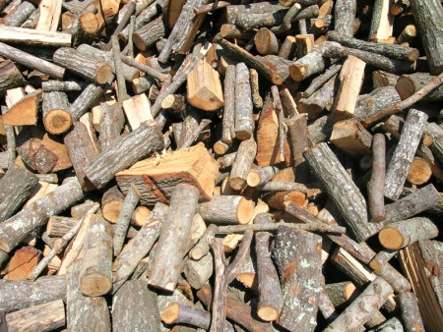
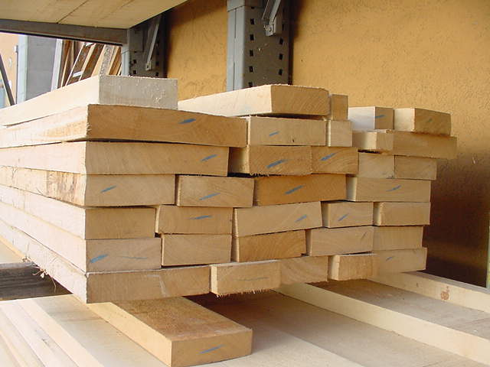

Arbitrariness of signs: the signified
Arbitrariness: of signifier and also of signified
BOIS
(in French)
legna
legname
bosco
logs
boards
wood
Notes:
Different languages interpret reality in a different way, as if they were «cutting a paper into pieces» and adding a label to each piece. In this sense, the signified is also arbitrary. For example, Eskimos have many different words for different kinds of snows/ice, while Italians have just one word.
This means that our perception of reality is filtered by our mother tongue (as well as by what we know, what we like…).
The richer the vocabulary, the more detailed our perception of reality is – but the more conditioned too.

Slide 7
What is a «text»?
Text: an extended structure of syntactic units; every meaningful linguistic production, both oral and written… (broad sense)
Notes:
The TEXT in the sense of utterance, concrete linguistic production, is the place where all the intermediate structures cooperate to (hopefully) communicate a clear, non ambiguous message. Thus, the real “sign” is the text.
Intermediate structures, as long as they are in the “language” and not used, are extremely fuzzy, waiting for a concrete situation of use to disambiguate their possible meaning. It is not until I use a sentence like “I’m going home” that the lexeme “go” gets to mean “to move”.
Furthermore, we may notice that it is not until someone very specific says “I’m going home” that “home” becomes a specific place….

Slide 8
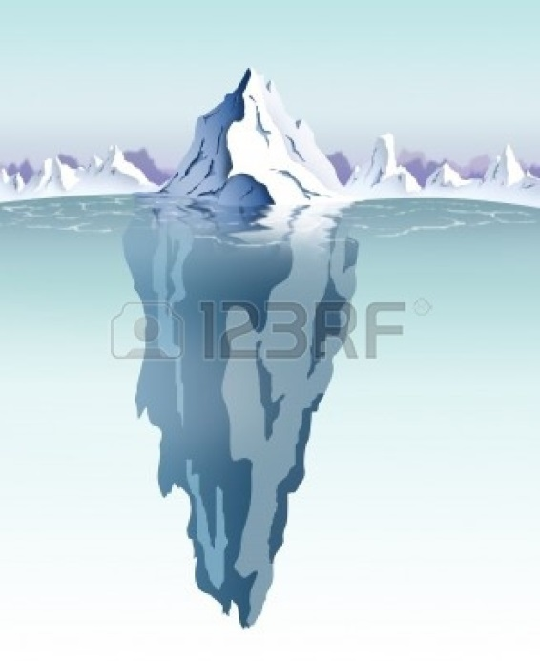
How are texts interpreted?
Verbal components of communication
Non verbal components of communication

Slide 9
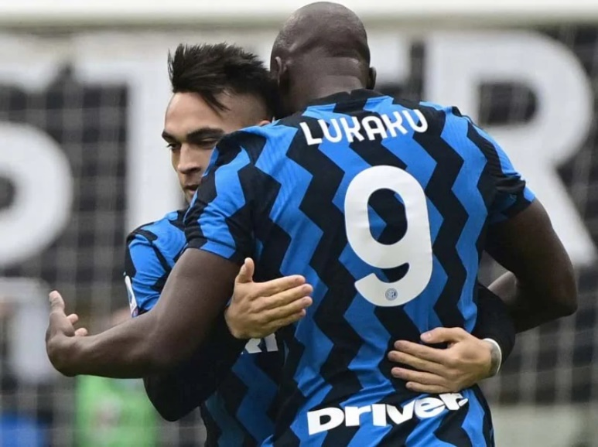
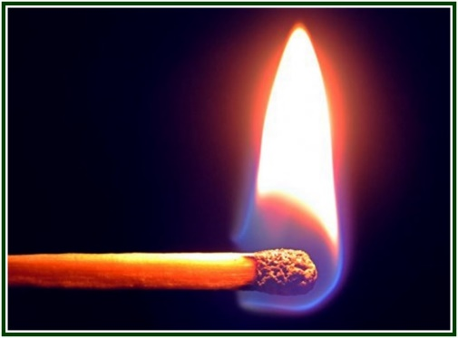
The co-text/1
Co-text: the “text around”
Example: we won the match!
Notes:
Co-text: the «text around». E.g. if we say «We won the match» it’s the co-text that makes it clear that «match» means competition and not «stick for lighting fire».
.

Slide 10
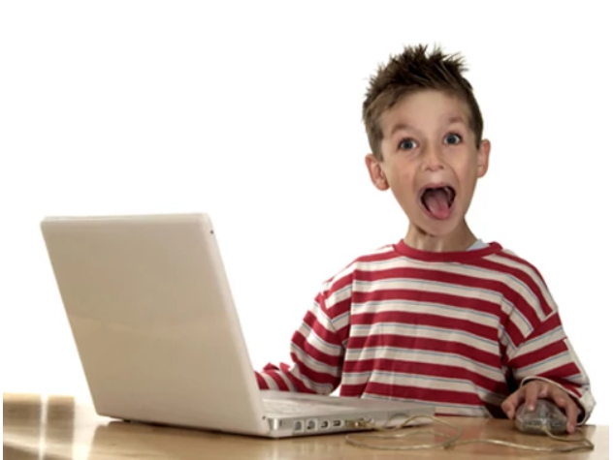
The co-text/2
The other sentences
Aldo asked me for 10k euros
He had loaned me 5k
He had loaned me 15k
The arrangement of the sentences
Louis is quite good. His dad has bought him a PC
His dad has bought him a PC. Louis is quite good
Notes:
If I complete the sentence with “He had loaned me 5k», Aldo is a loan shark. If instead I complete it with «He had loaned me 15k», he is good and kind.
As regards Louis: in the first sentence the PC is a reward; in the second, I am talking about his computer science skills.

Slide 11
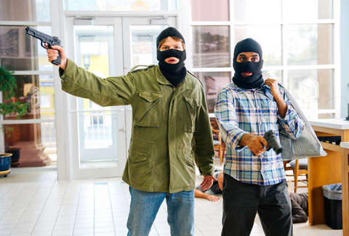

The con-text
Con-text: the “world around the text”
It’s 10.30!
Pass me the book…
Notes:
Context: the environment in broad sense. «Give me the book»: what book becomes clear through the context (e.g. the one on a table I’m directly looking at). The 10.30 means «we are late!» during a rubbery is related to the context (e.g. we know guards will be back in a few minutes).

Slide 12
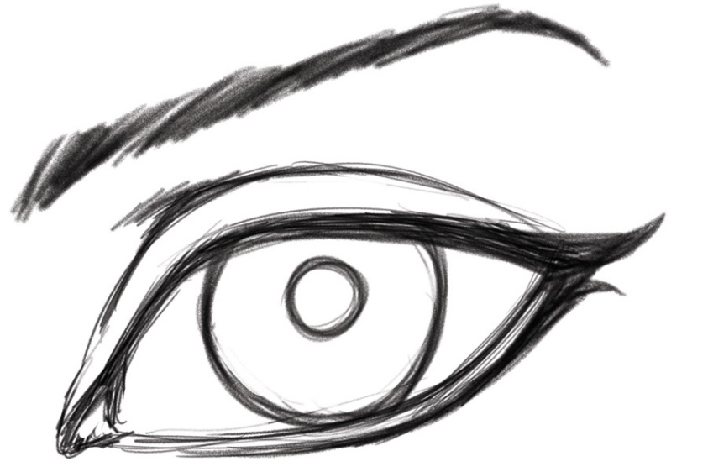
The “encyclopedia”
Our background knowledge about “the world”
Red eyes
Black eyes
Green eyes
White (of the) eyes
Notes:
Background knowledge: we understand what part of the eye we are speaking about thanks to our knowledge of the world. We know that eyes can’t be red in the pupil, so it must be the surrounding area

Slide 13
Reference
Communication needs to be understandable – i.e. the addressee needs to be capable of «locating» what the sender is talking about
Communication has to build upon a «common ground» (i.e. common knowledge) between the interlocutors
Notes:
COMMON GORUND: Individuals engaged in conversation must share knowledge in order to be understood and have a meaningful conversation (Clark, 1985).

Slide 14
Common ground
Two mistakes:
Taking pieces of knowledge that are not shared for granted (the most common mistake)
Not taking for granted pieces of knowledge, beliefs and/or information that are shared. This kind of mistake, less common, originates verbose communications

Slide 15
Example
5G RADIO ACCESS
CAPABILITIES AND TECHNOLOGIES
The capabilities of 5G wireless access must extend far beyond previous generations of mobile communication. Examples of these capabilities include very high data rates, very low latency, ultra-high reliability, energy efficiency and extreme device densities, and will be realized by the development of LTE in combination with new radio-access technologies. Key technology components include extension to higher frequency bands, access/backhaul integration, device-to-device communication, flexible duplex, flexible spectrum usage, multi-antenna transmission, ultra-lean design, and user/control separation.
(Ericsson White paper, Uen 284 23-3204 Rev C | April 2016)
Notes:
This text is neither right nor wrong in terms of common ground: being right or wrong depend on WHO the intended addressee is. It is crucial to know what kind of knowledge is shared with the addressee and can be therefore taken for granted.

Slide 16
Tips
ACRONYMS: ALWAYS solve them, at least the first time you introduce them
Even if writing/communicating to a technical audience – introduce a statement every now and then that could be clear for anyone
Long Term Evolution (from now on, LTE)
Long Term Evolution (LTE)
LTE (Long Term Evolution)

Slide 17
How should a good text be

Slide 18
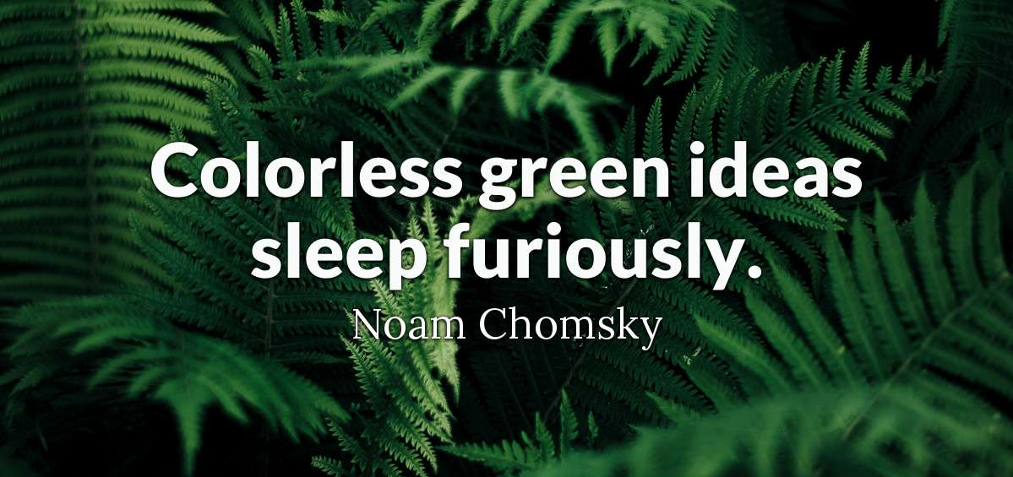
Correct: grammar & semantics

Slide 19
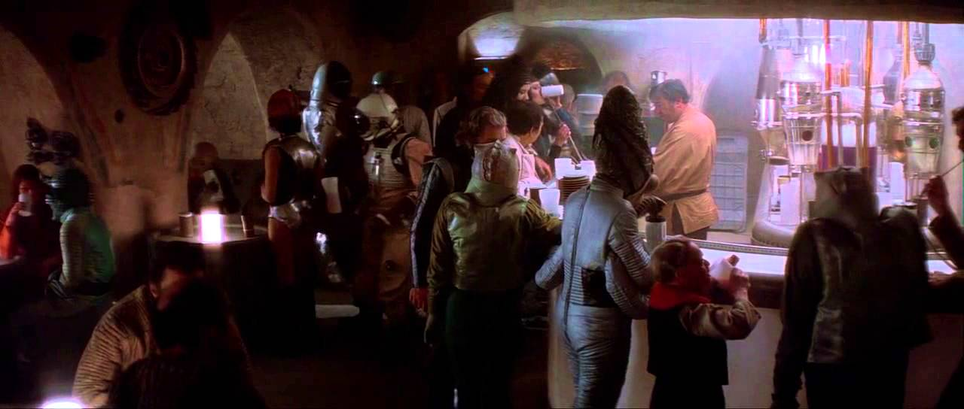
Informative
Mary has got 2 eyes

Slide 20

Relevant

Slide 21
Relevant
A text has to be relevant
Every good text answers the question it was created for
The question can be explicit or implicit (the underwater part of the iceberg)

Slide 22
END

